Slide 1

Flight Fare Forecasting

Slide 2




Team - 10
Kowsalya Mayaluri Data Integration
Venkata Sai Mohan Team Lead,
Data Engineer
Pranitha Beereddy Data Collection & Cleaning
Susendranath Data Visualization

Slide 3
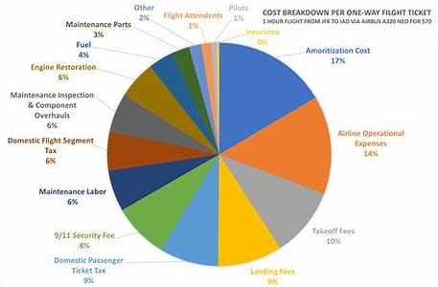
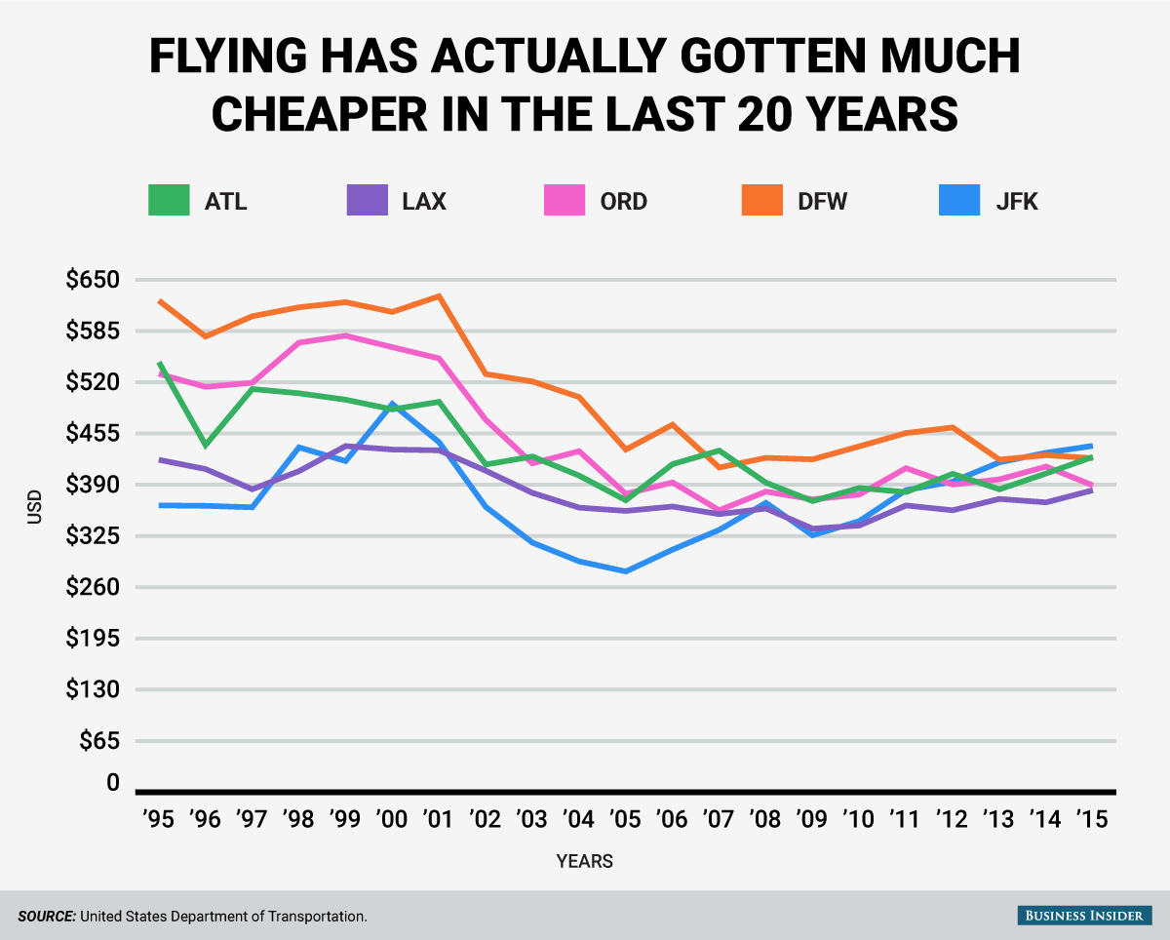
Business Question
"How can we use data engineering to streamline the process of comparing flight prices across different airlines and booking platforms?"

Slide 4
The Solutions
Data Aggregation and Normalization
Enhanced Customer Experience
Cost-Effective Travel Options
01
02
03

Slide 5
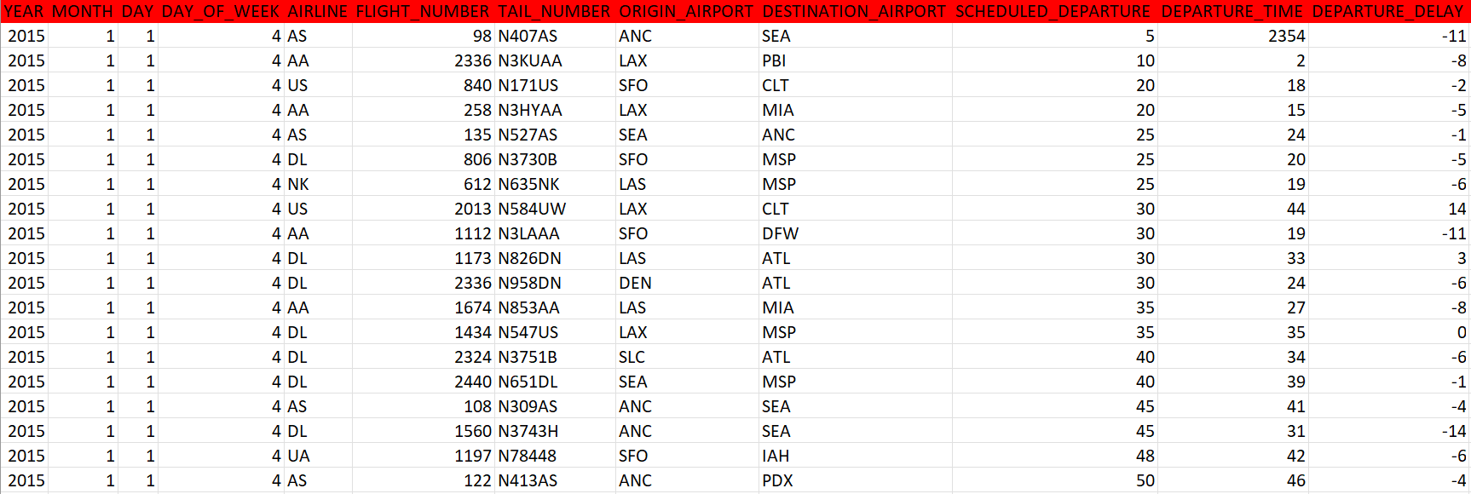
Data Overview
The sample dataset is collected from Kaggle.

Slide 6
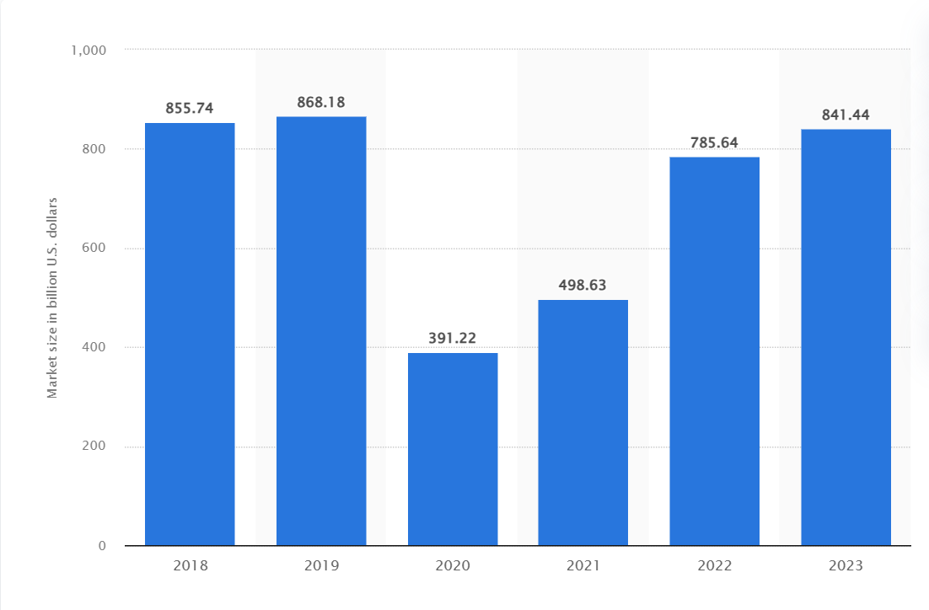
Total Market Size
Market size of the airline industry worldwide from 2018 to 2023 (in billion U.S. dollars)

Slide 7
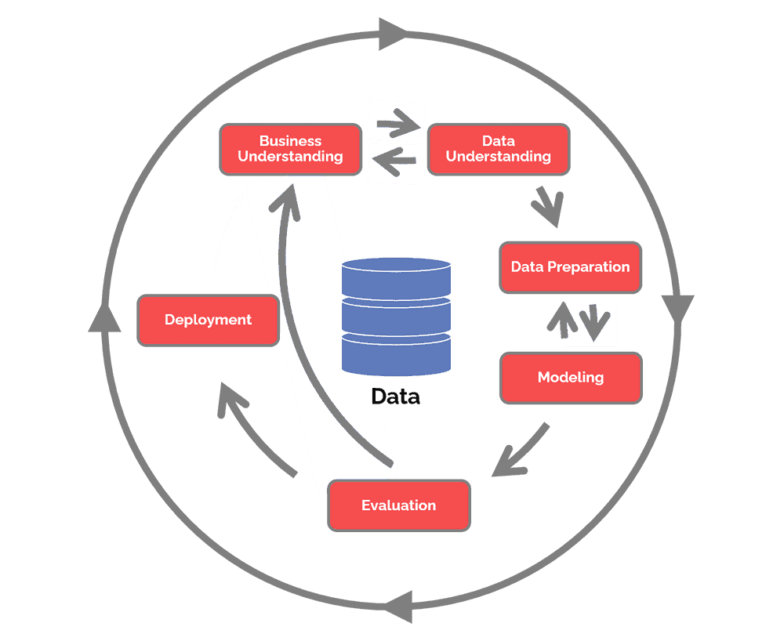
METHODOLOGY CRISP-DM

Slide 8
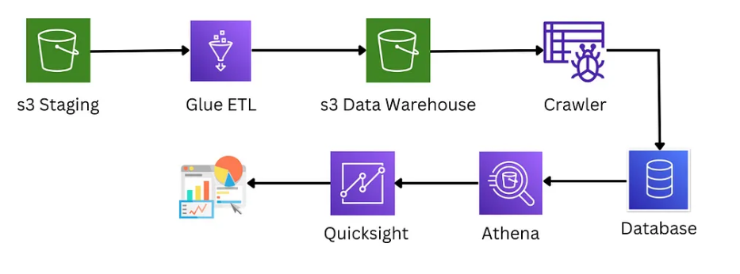
Project Pipeline

Slide 9






Technologies
S3 Bucket

Slide 10
Measuring Success
Accuracy of Price Comparison
Customer Satisfaction

Slide 11

References
https://aws.amazon.com/blogs/architecture/field-notes-applying-machine-learning-to-vegetation-management-using-amazon-sagemaker/
Global airline industry market size 2023 | Statista
https://docs.aws.amazon.com/glue/latest/dg/add-crawler.html
https://docs.aws.amazon.com/index.html
https://docs.aws.amazon.com/s3/?icmpid=docs_homepage_featuredsvcs
https://medium.com/@dinunirmani9d/end-to-end-data-pipeline-on-aws-using-s3-glue-athena-and-quicksight-1a93402418fa

Slide 12
Thank you

